Slide 1
Implementing Domain Driven Design (DDD)
a practical guide

Slide 2


ABOUT ME Halil İbrahim Kalkan
Co Founder
Web: halilibrahimkalkan.com
Github: @hikalkan
Twitter: @hibrahimkalkan

Slide 3
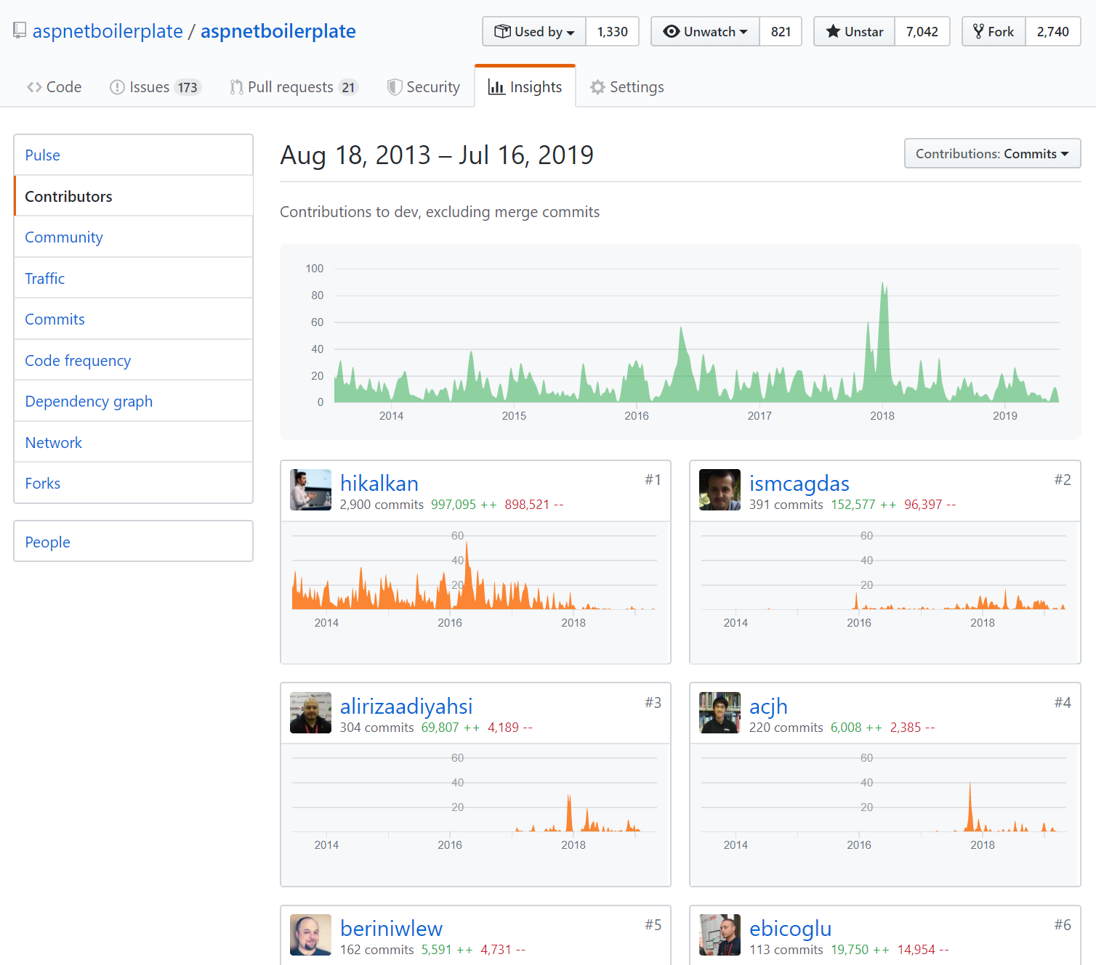
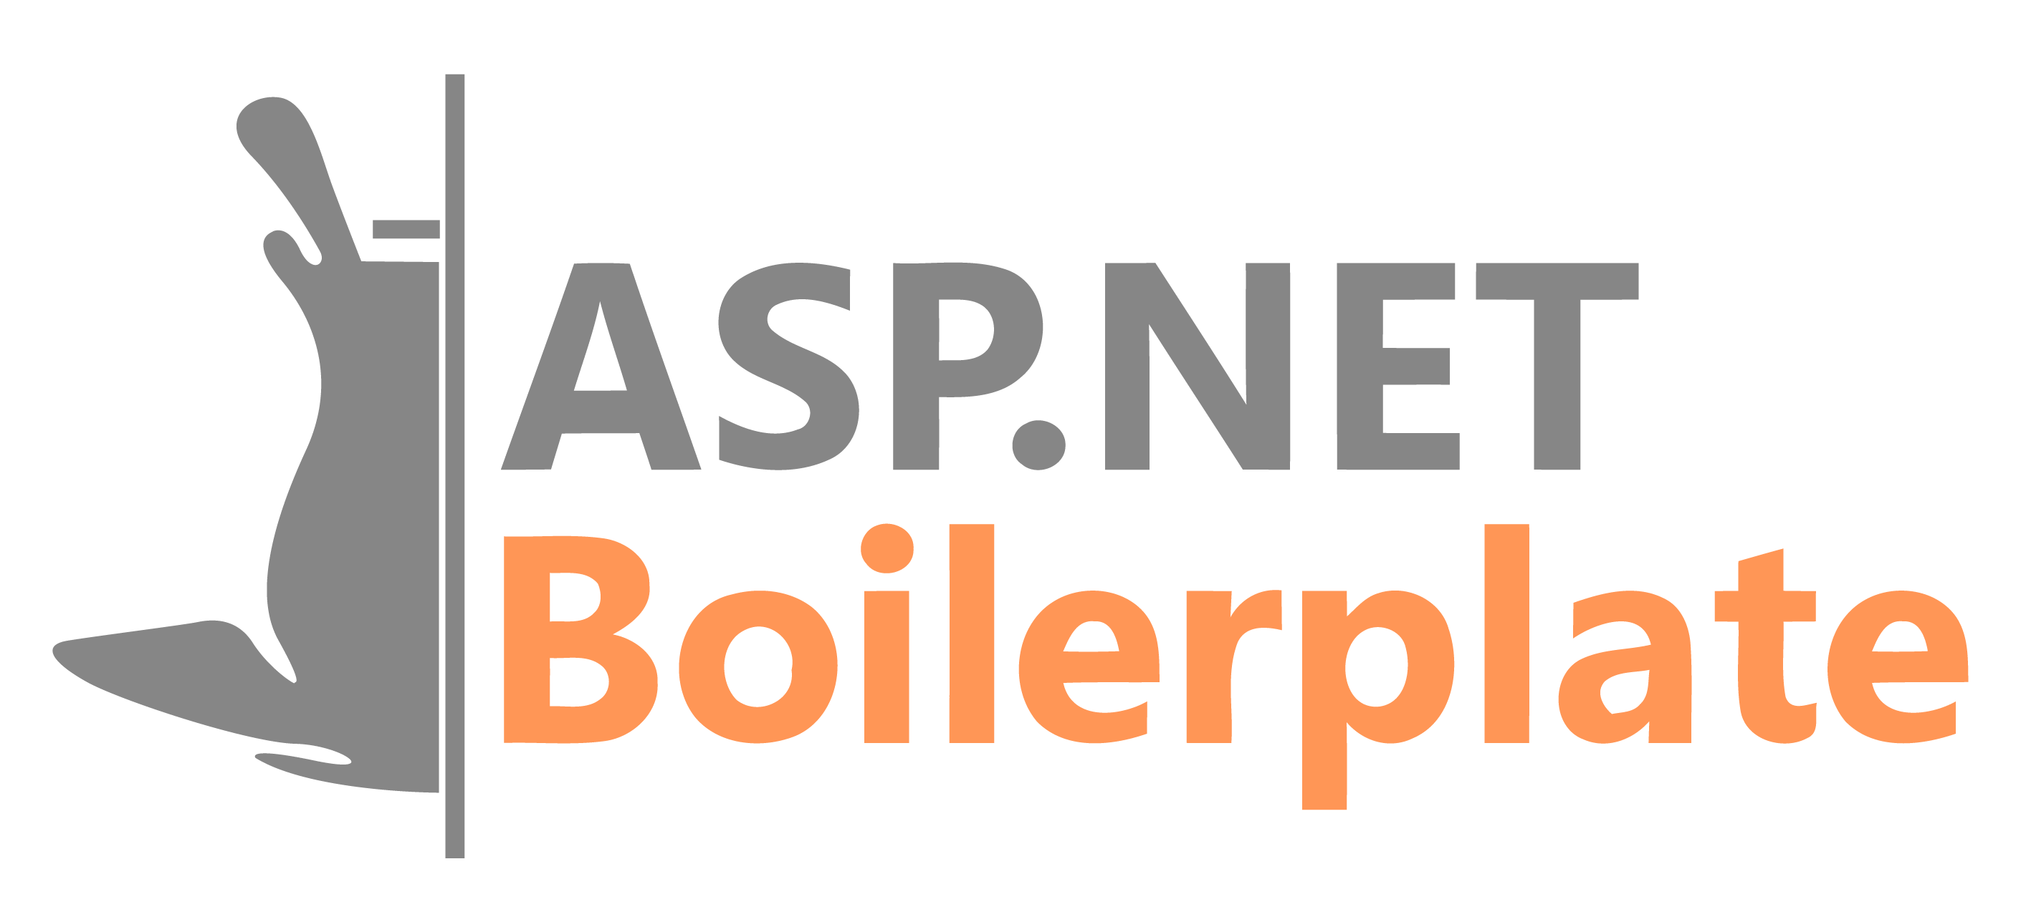
ASP.NET BOILERPLATE
7.000+ stars on GitHub
1.300.000+ downloads on Nuget
https://aspnetboilerplate.com

Slide 4
Agenda
Part-I: What is DDD?
Architecture & layers
Execution flow
Building blocks
Part-II: Implementing DDD
Layering a Visual Studio solution
Rules & samples

Slide 5
Part-I: What is DDD?

Slide 6
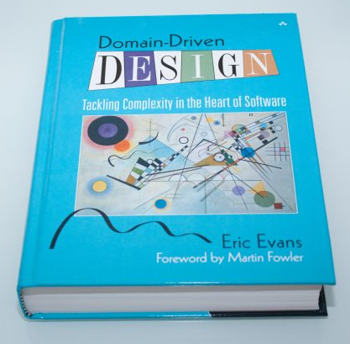
What is DDD?
Domain-driven design (DDD) is an approach to software development for complex needs by connecting the implementation to an evolving model
Focuses on the core domain logic.
Suitable for complex domains and large-scale applications.
Helps to build a flexible, modular and maintainable code base, based on the Object Oriented Programming principles.

Slide 7
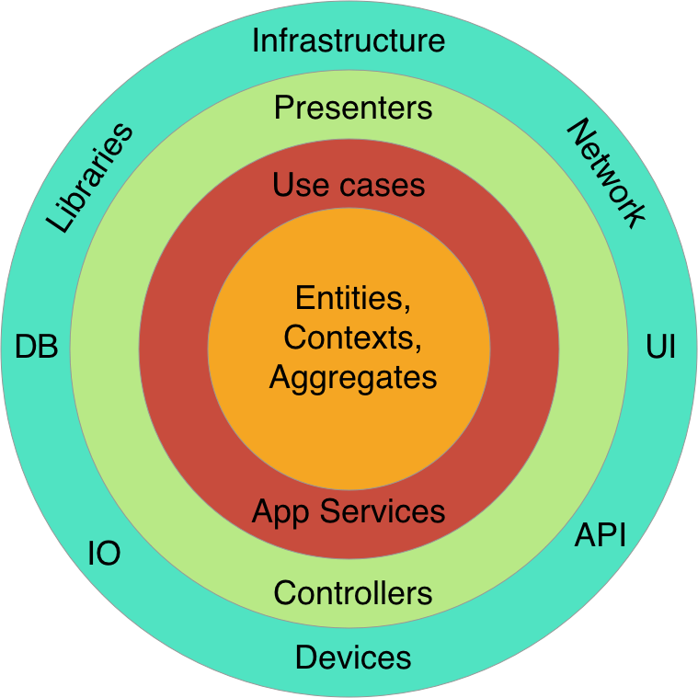
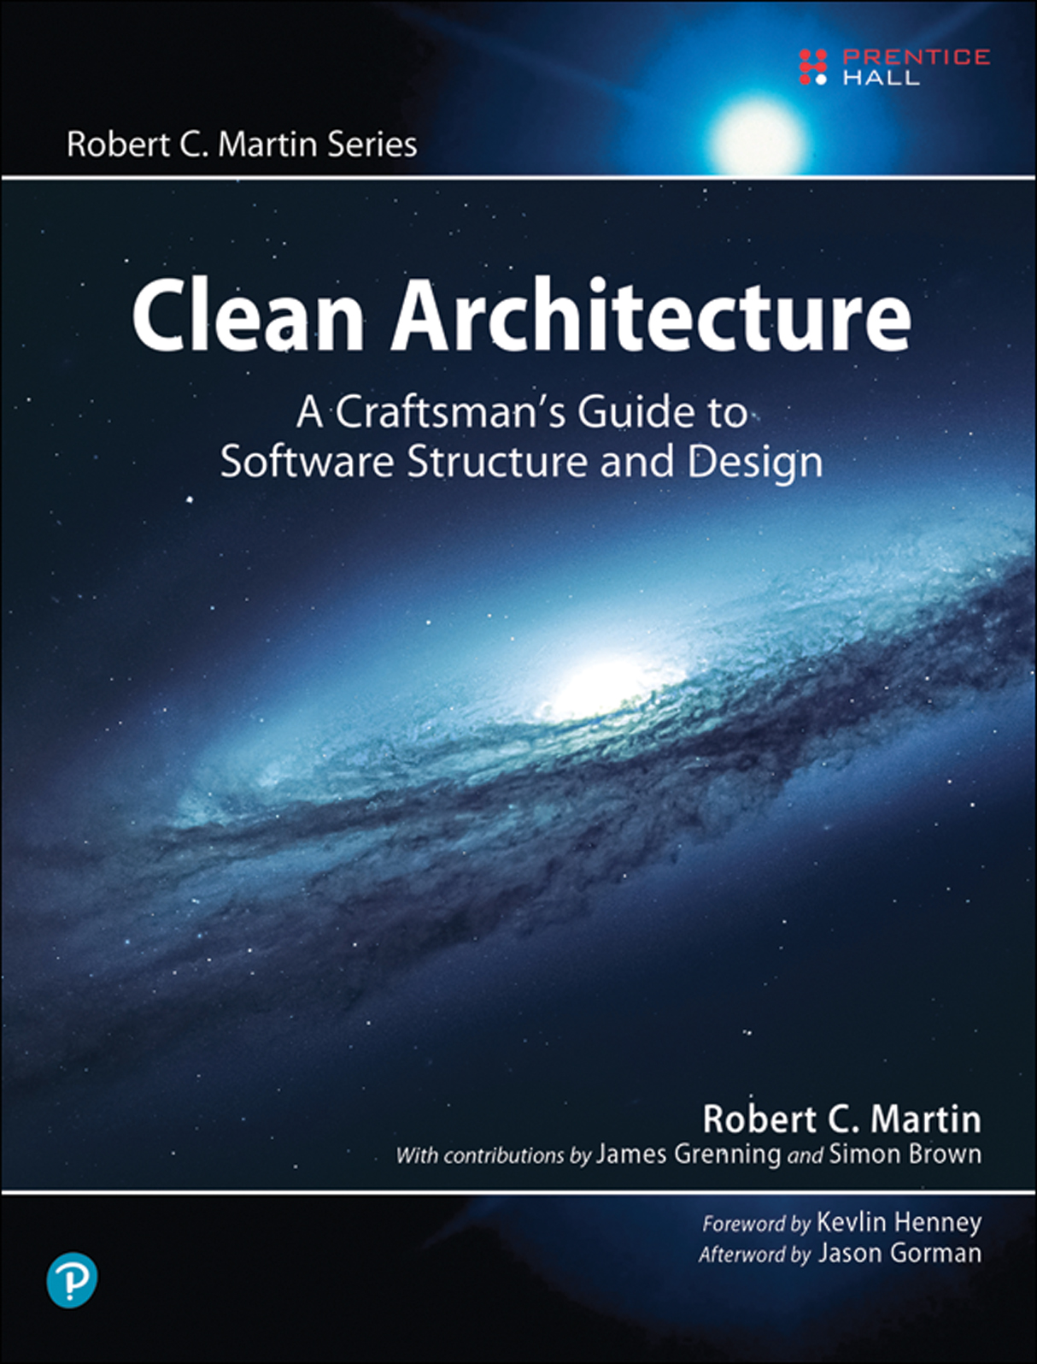
Domain Driven Design Layers / Clean Architecture
Infrastructure
Layer
Presentation Layer
Application Layer
Domain Layer

Slide 8

Domain Driven Design Execution Flow
PRESENTATION layer
APPLICATION layer
DOMAIN layer
HTTP request
Entities
Browsers
MVC UI
DTO
html/js/css
Application
Services
Domain Services
HTTP request
Remote clients
HTTP API
DTO
Repositories (interface)
JSON
Distributed Services
Layer
Exception Handling
Audit Logging
Caching
Authorization
Validation
Authorization
Validation
Unit of Work / DB Transaction
C r o s s C u t t i n g C o n c e r n s

Slide 9
Domain Driven Design Core building Blocks
Domain Layer
Entity
Aggregate Root
Value Object
Repository
Domain Service
Specification
Domain Events
Application Layer
Application Service
Data Transfer Object (DTO)
Unit of Work

Slide 10
Domain Driven Design Common Rules
Database / ORM independence
Presentation technology agnostic
Doesn’t care about reporting / mass querying
Focuses on state changes of domain objects
…TODO

Slide 11
Part-III: Implementation
Implementing Domain Driven Design (DDD)

Slide 12
Aggregate Roots Principles
Should maintain self integrity & validity
Implements domain rules
Saved & retrieved as a single unit (with sub-collections)
TODO: Show a picture of an aggregate with a root & collections

Slide 13
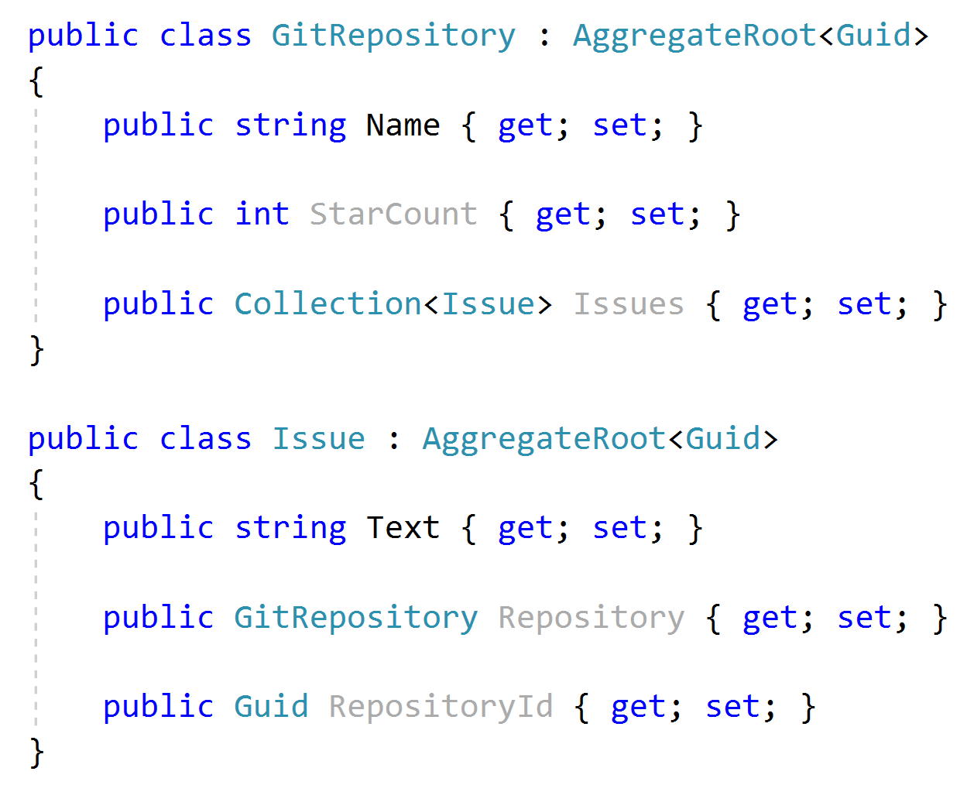


Aggregate Roots Rule: Reference other aggregates by Id

Slide 14
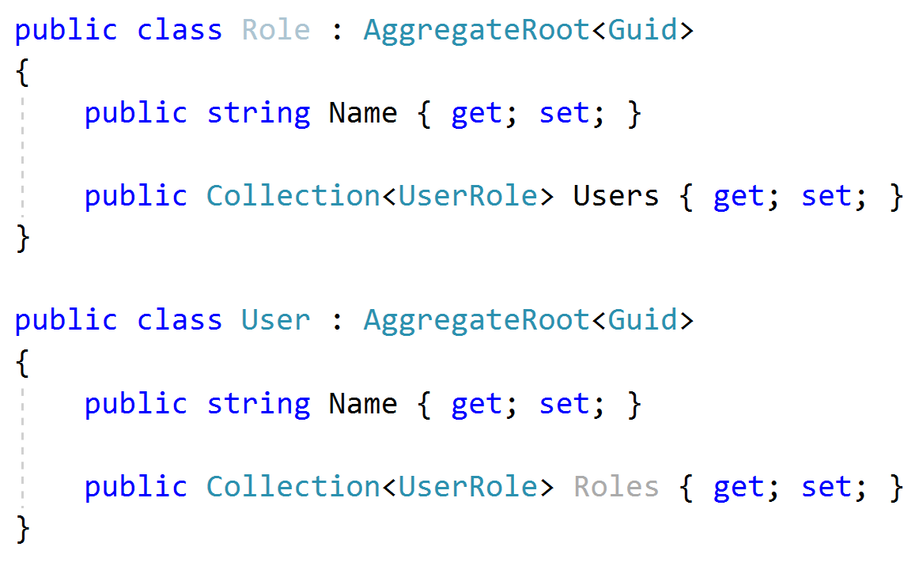
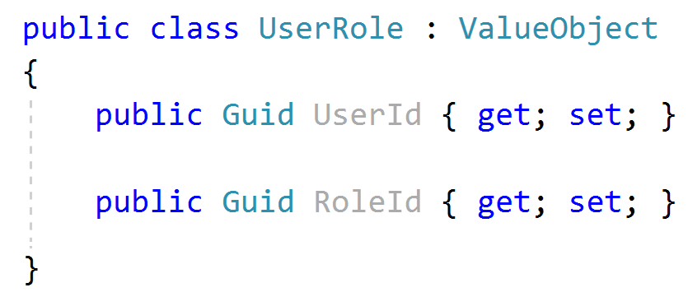
Aggregate Roots Tip: Keep it small
Considerations;
Query Performance
Data Integrity & Validity
Should be serializable (required for NoSQL databases)

Slide 15
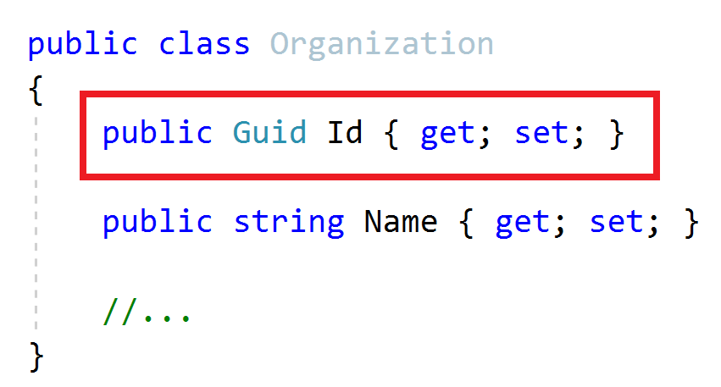
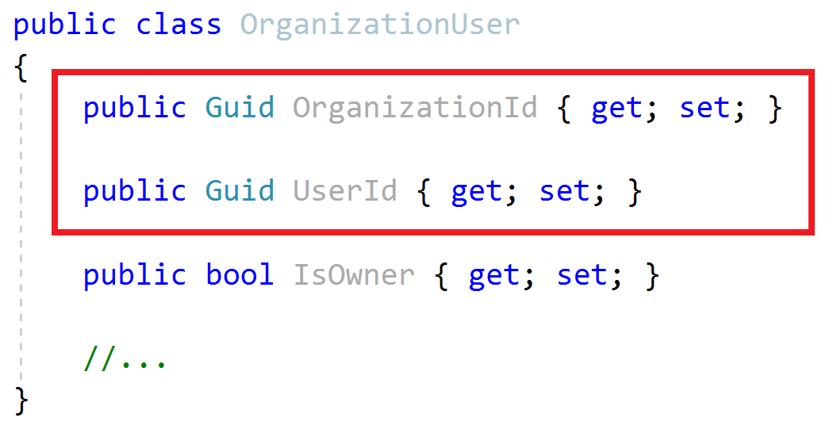
Aggregate Roots / Entities Primary Keys
Aggregate Root
Entity
Define a single Primary Key (Id)
Define a composite Primary Key
Suggestion: Prefer GUID as the PK

Slide 16
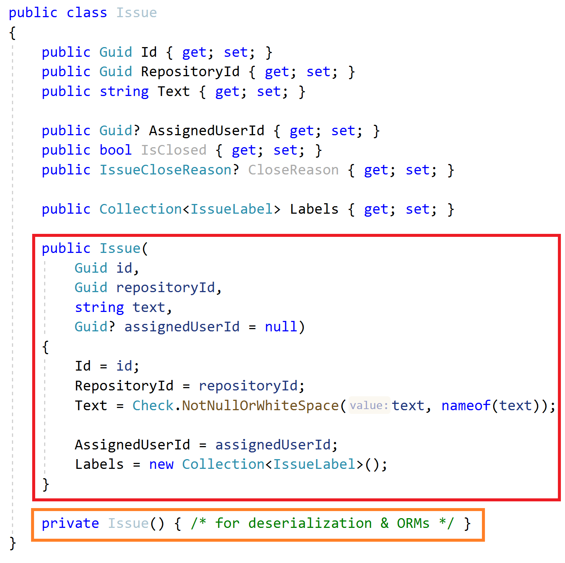
Aggregate Roots / Entities Constructor
Force to create a VALID entity
Get minimum required arguments
Initialize sub collections
Get id as an argument (don’t use Guid.NewGuid())
Use a service to create GUIDs, like IGuidGenerator
Create a private default constructor for ORMs & deserialization

Slide 17
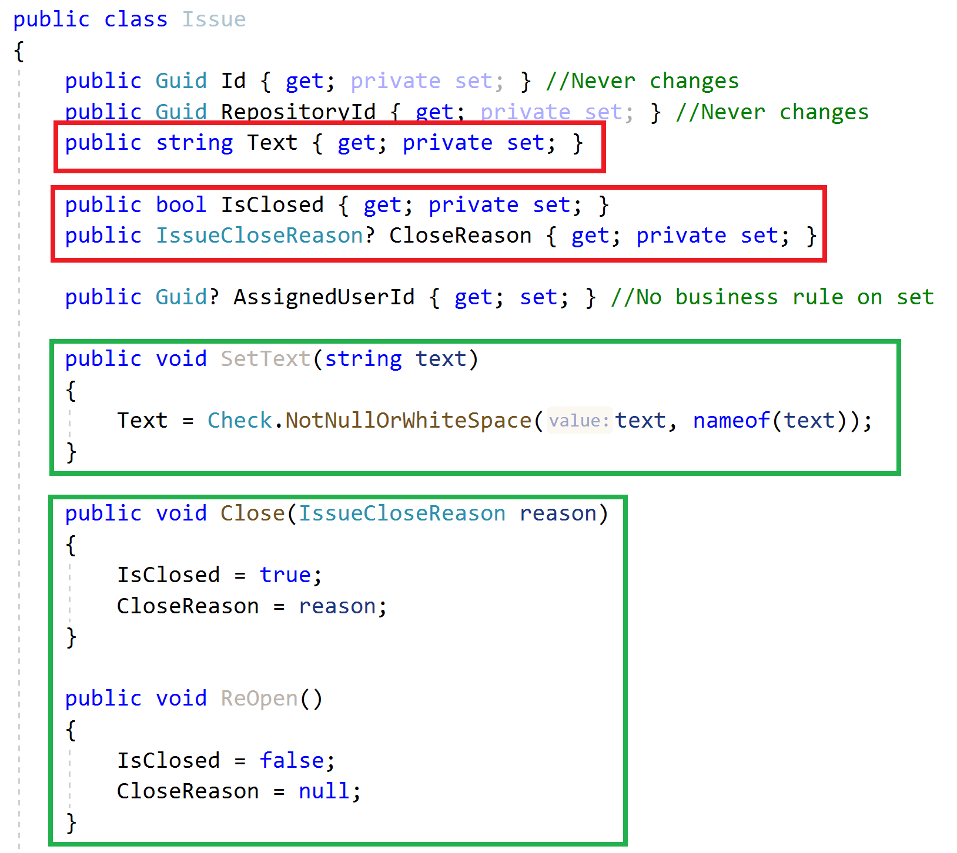
Aggregate Roots / Entities Property Accessors / Methods
Maintain object VALIDITY
Use private setters
Change properties via methods

Slide 18
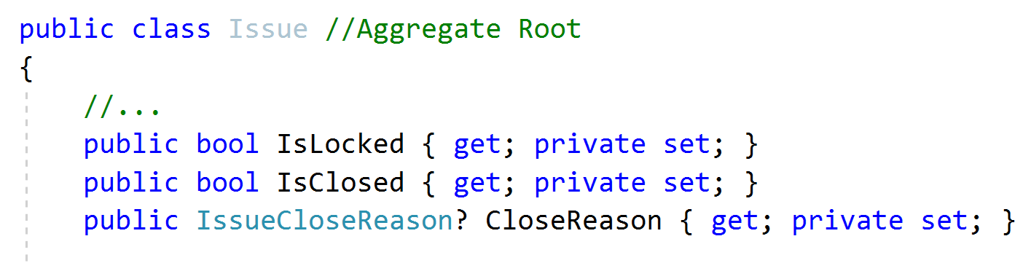
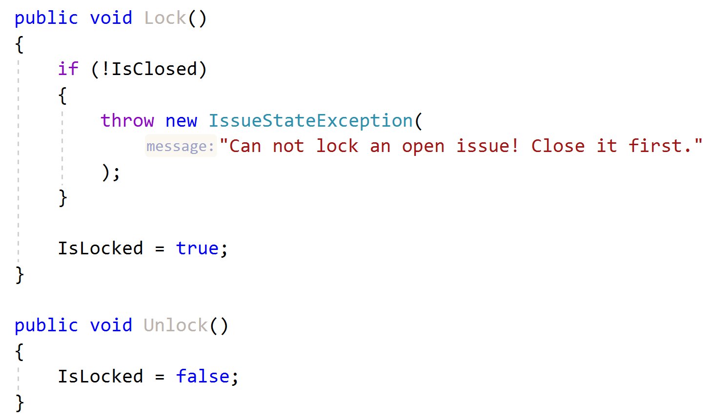
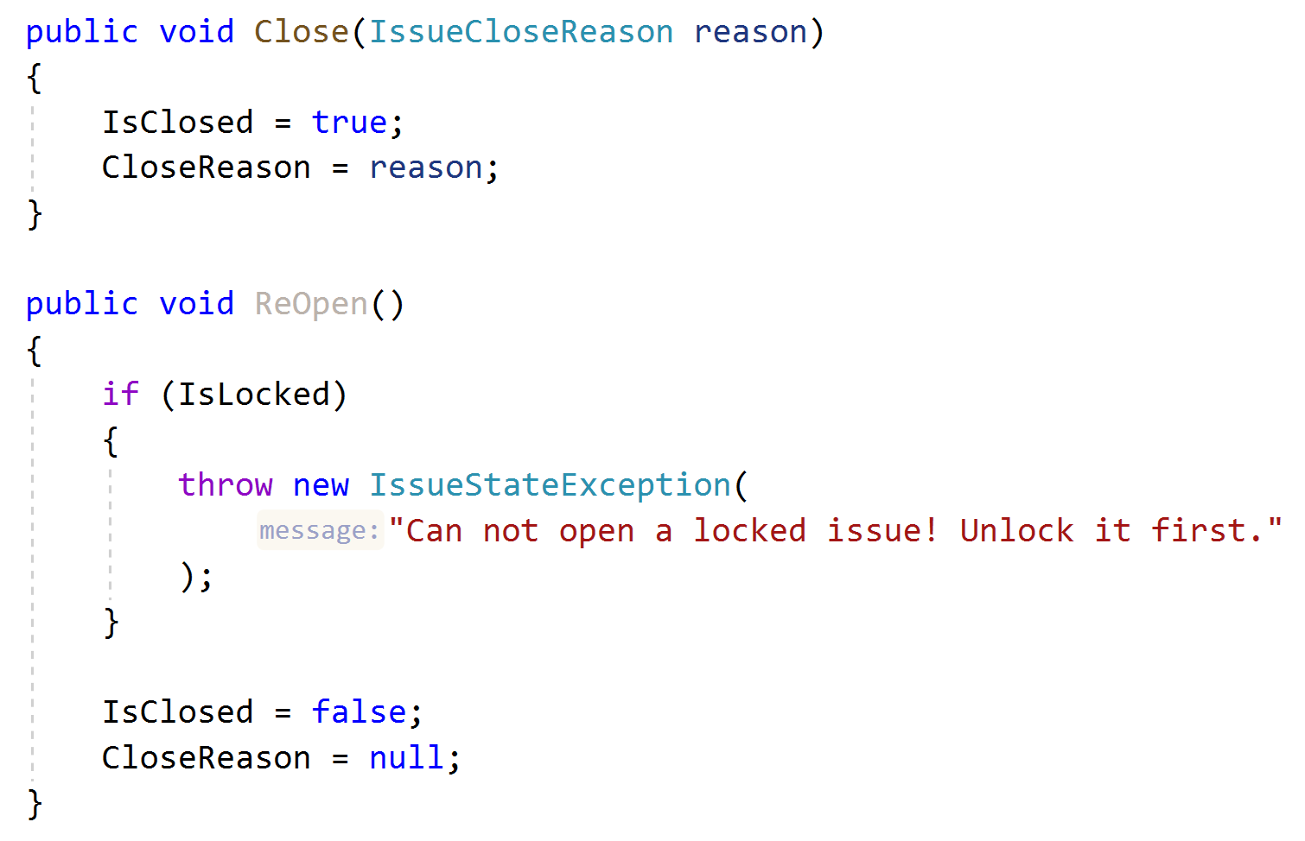
Aggregate Roots / Entities Business Logic & Exceptions
Implement Business Rules
Define a good method name matches to the domain action
Define and throw specialized exceptions

Slide 19
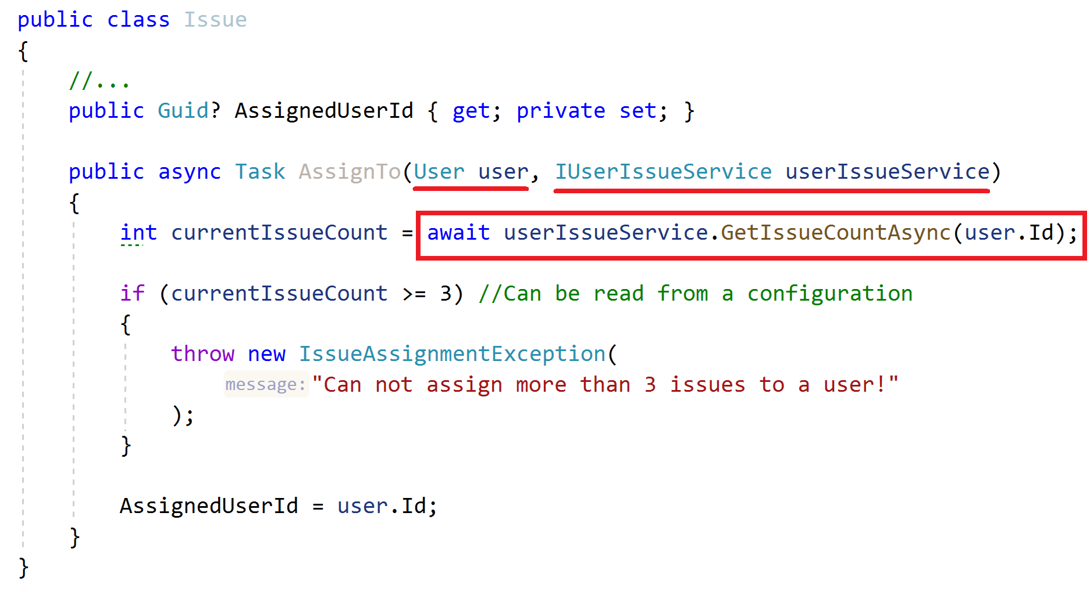
Aggregate Roots / Entities Business Logic
How to implement when you need external services?
Business Rule: Can not assign more than 3 issues to a user!

Slide 20
Aggregate Roots / Entities Business Logic
How to implement when you need external services?
Business Rule: Can not assign more than 3 issues to a user!
ALTERNATIVE..?
Create a Domain Service!

Slide 21
Repositories Principles
Define interface in the domain layer, implement in the infrastructure
Do not include domain logic
Repository interface should be database provider / ORM independent
Create repositories for aggregate roots, not entities

Slide 22
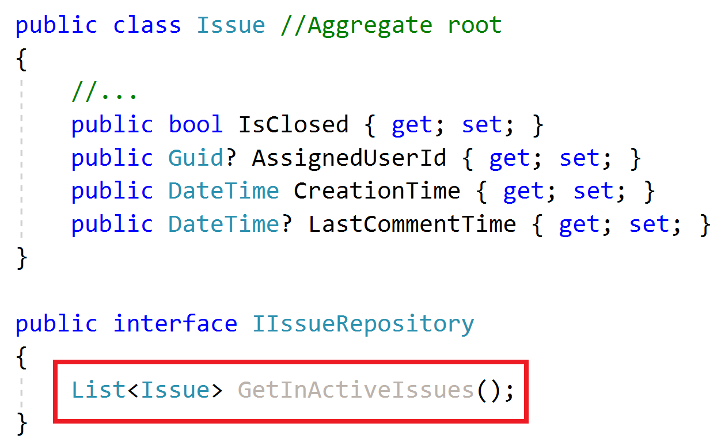
Repositories Do not include domain logic
What is an In-Active issue?

Slide 23
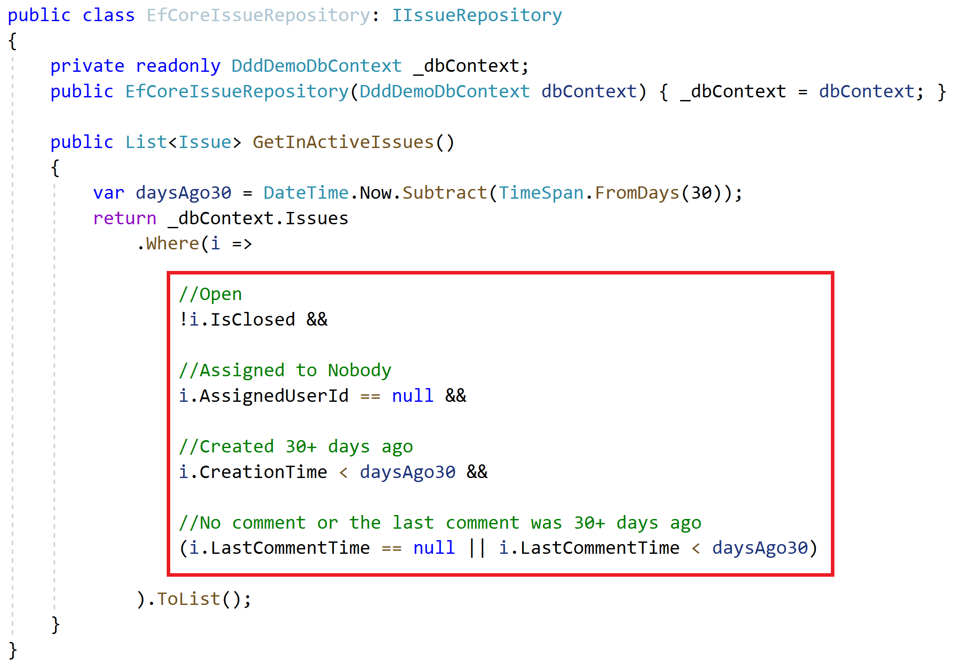
Repositories Do not include domain logic
Implicit definition of a domain rule!
How to re-use this expression? Copy/paste?

Slide 24
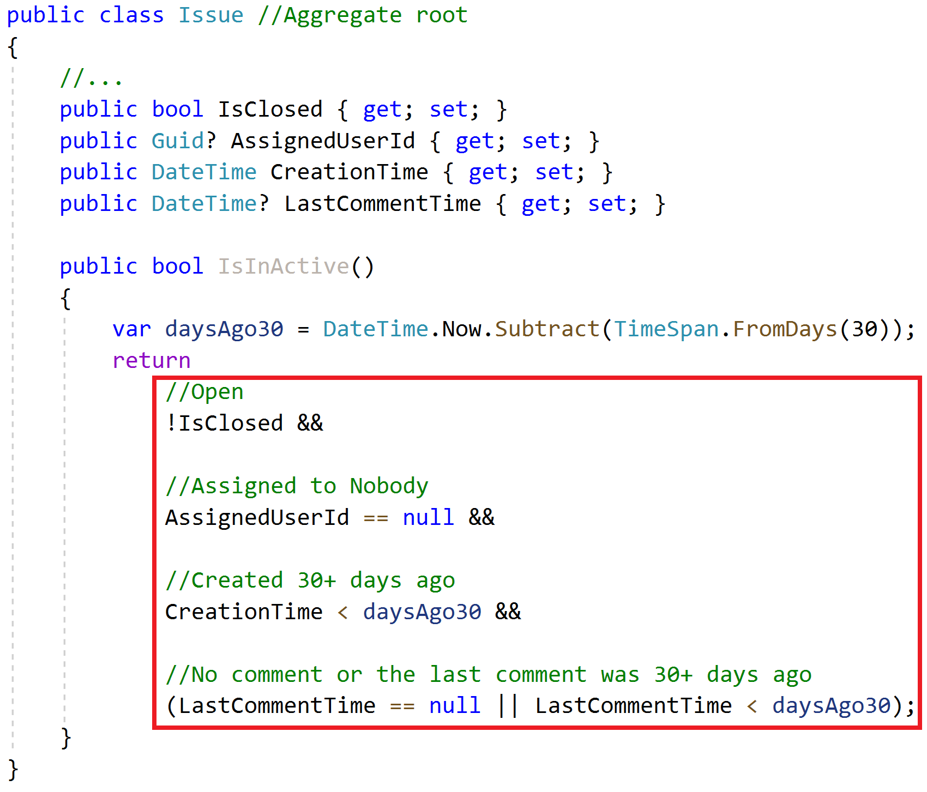
Repositories Do not include domain logic
Implicit definition of a domain rule!
How to re-use this expression? Copy/paste?
Solution: The Specification Pattern!

Slide 25
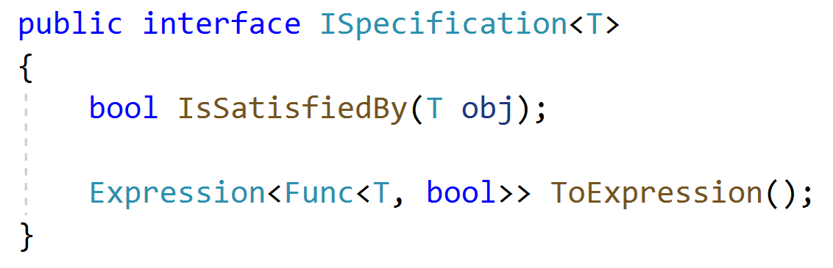
Specifications
A named, reusable & combinable class to filter objects.

Slide 26
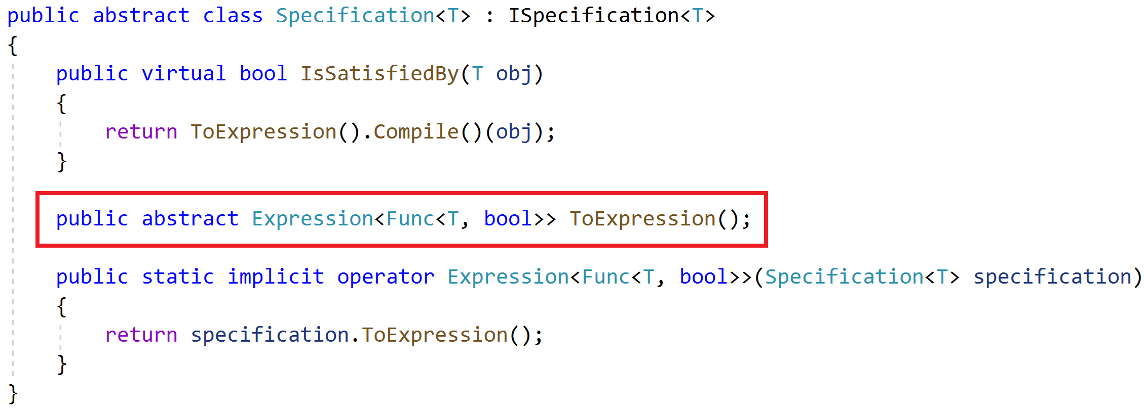
Specifications
A named, reusable & combinable class to filter objects.

Slide 27
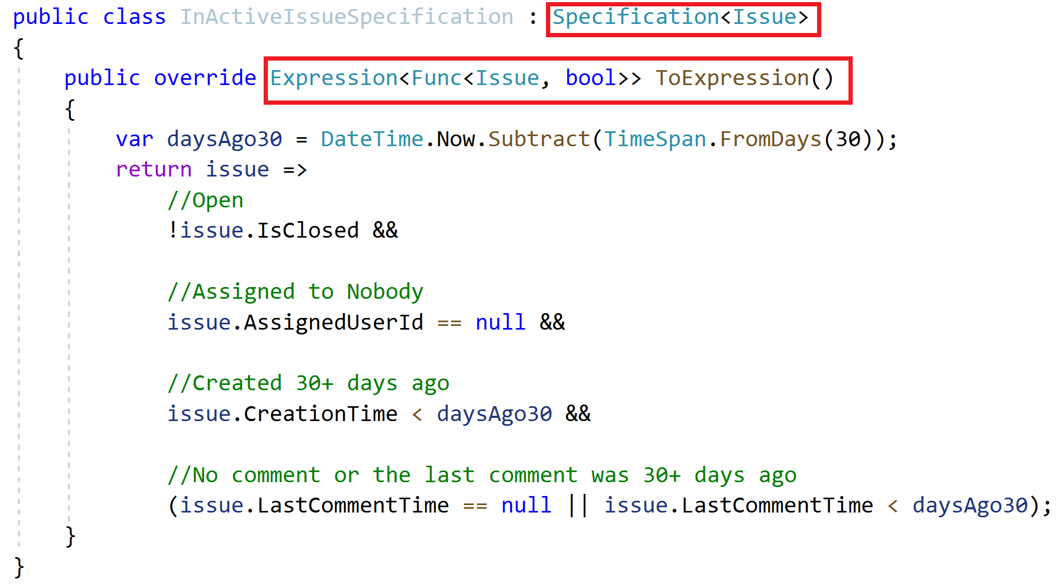
Specifications Define a specification

Slide 28
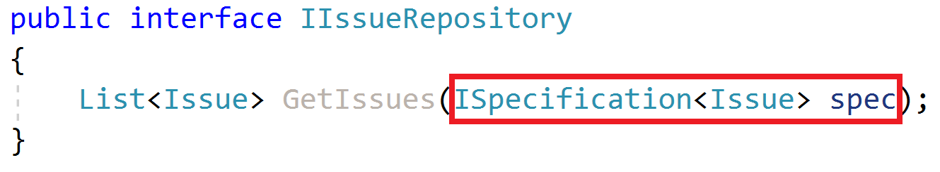
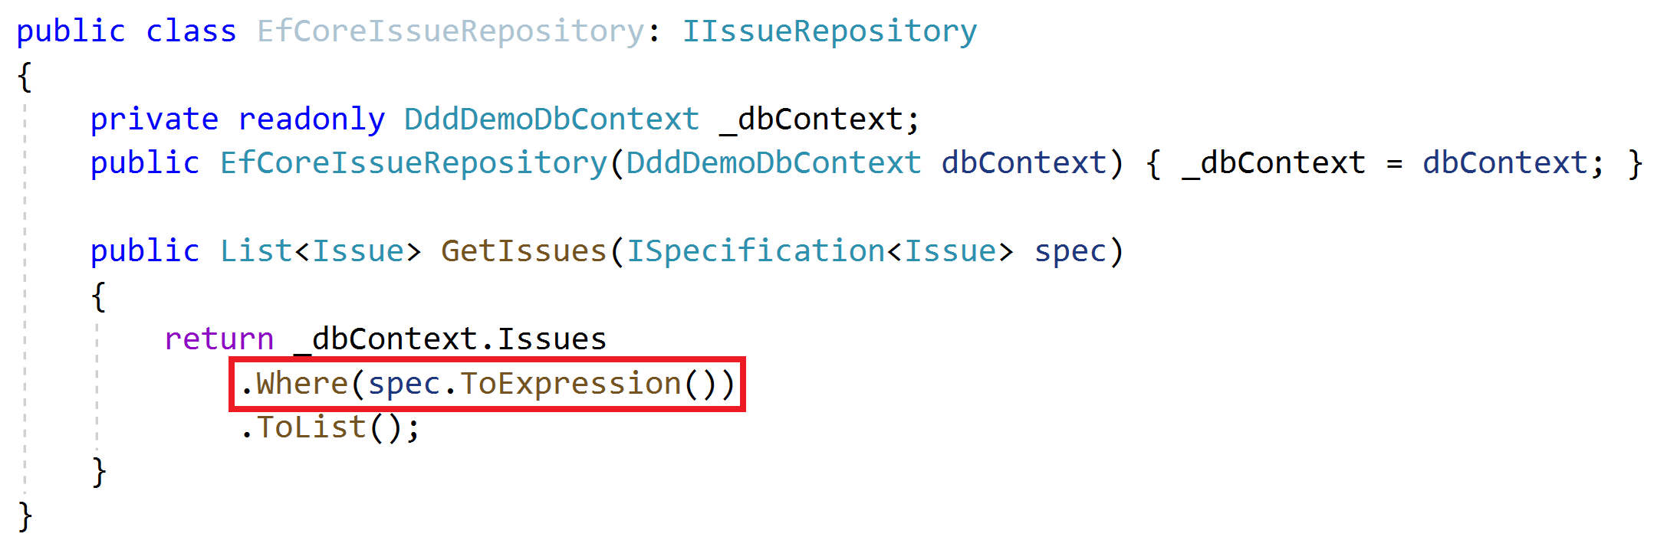
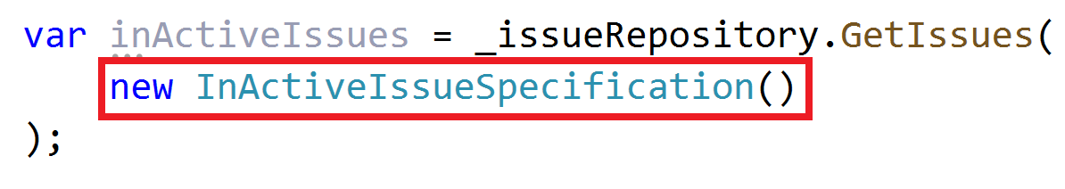
Specifications Use the specification

Slide 29
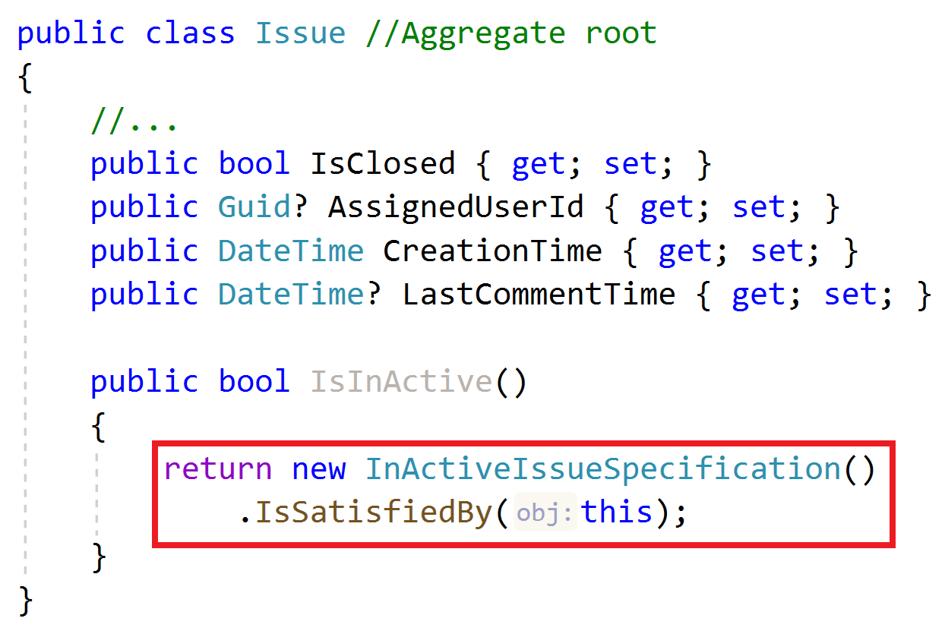
Specifications Use the specification

Slide 30
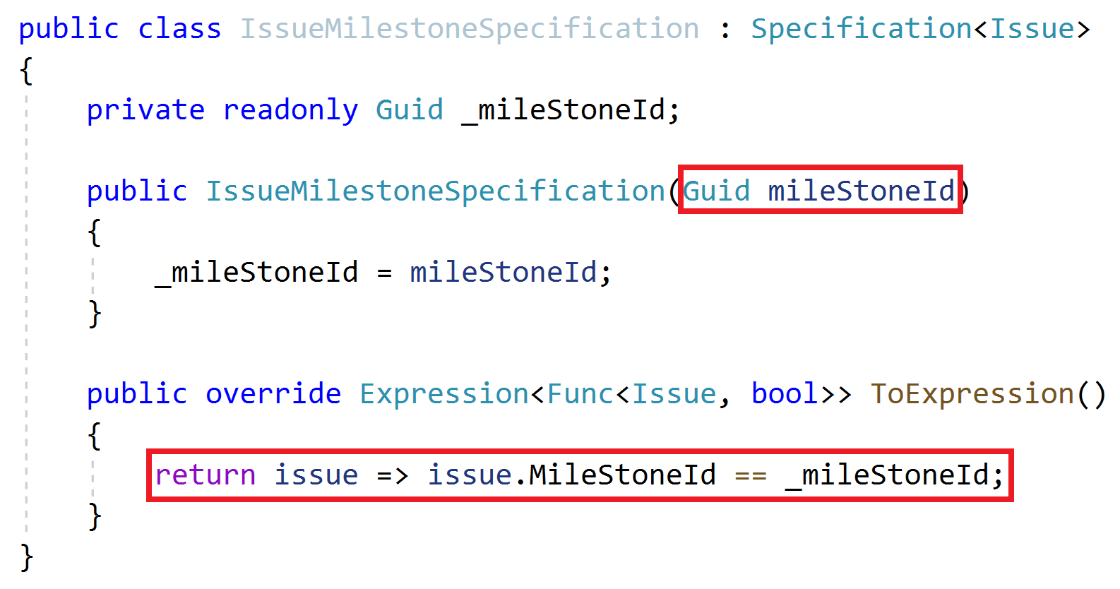
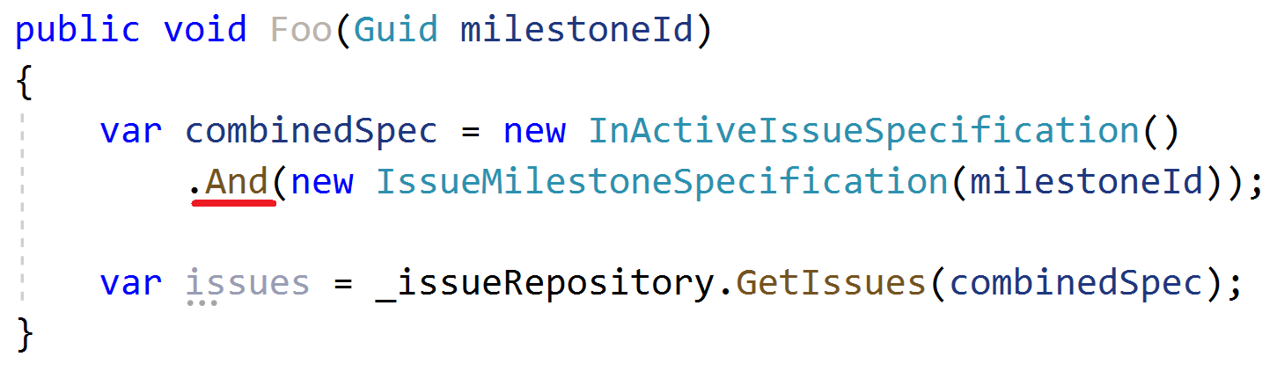
Specifications Combining Specifications

Slide 31
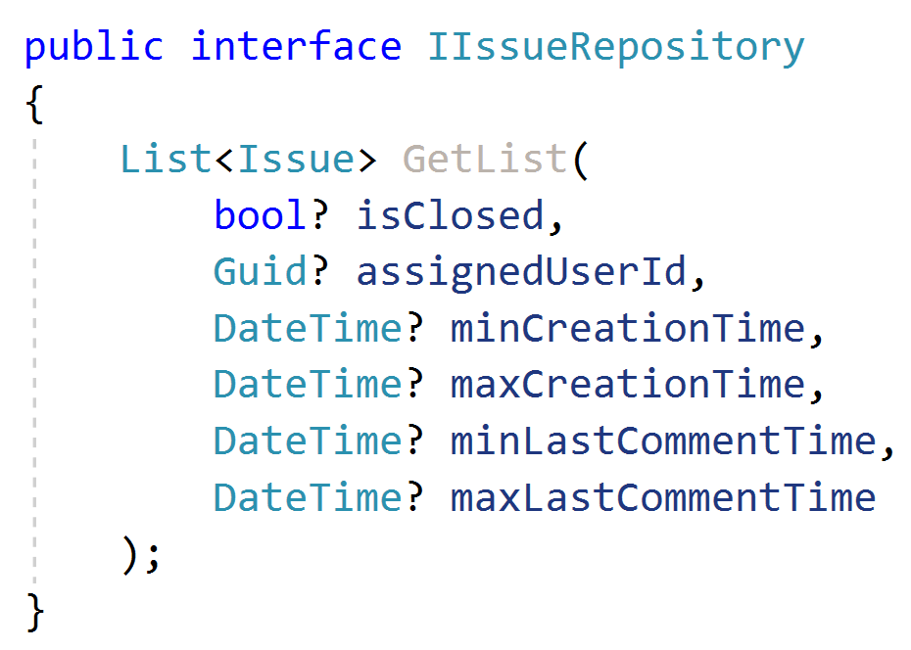
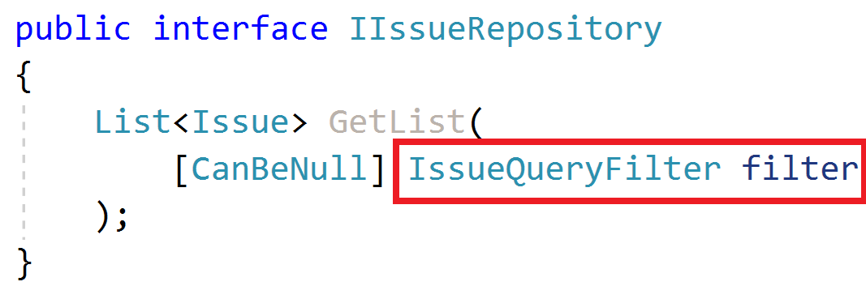
Repositories Querying

Slide 32
Repositories Querying / Read Models
Read model: A special entity-like class to read data from the database.
Minimize read models, do not use for single-entity operations
Define & use read models only in performance critical parts
TODO: Example
Do not reuse aggregate roots or entities inside read models
TODO: Example (UserWithRole, SimpleUser, DetailedUser… etc.)

Slide 33
Repositories Querying / Read Models
TODO…

Slide 34
Domain Services Principles
Implements domain logic;
Depends on services/repositories
Needs to work with multiple entities / entity types
Create for aggregate roots, not for entities
Work with domain objects, not DTOs

Slide 35
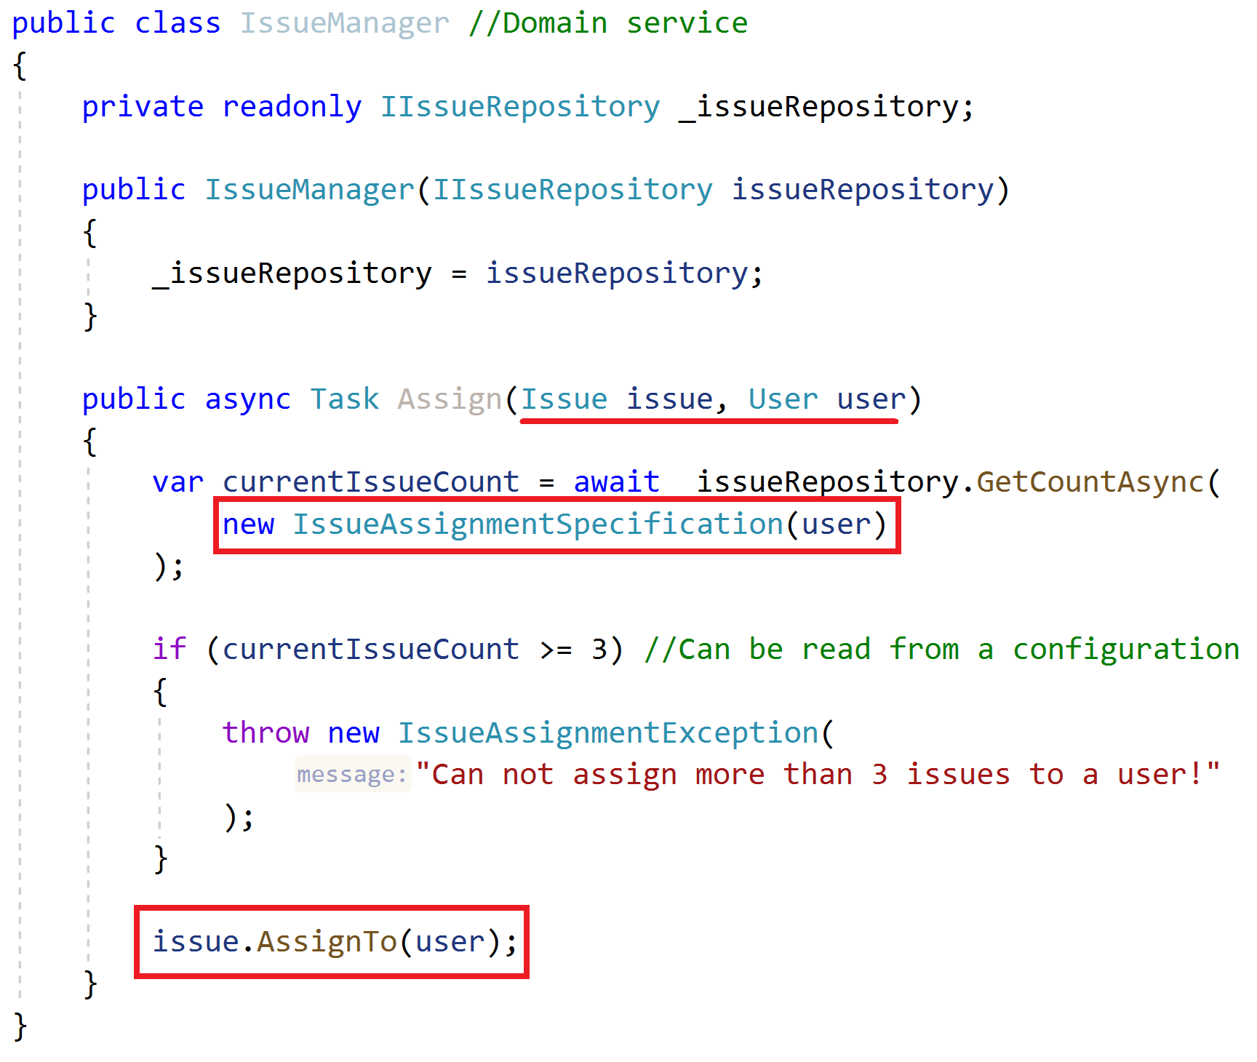
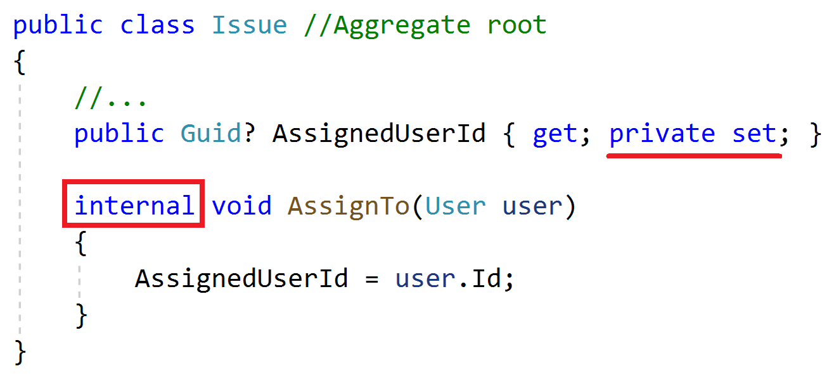
Domain Services Example

Slide 36
Domain Services More…
TODO

Slide 37
Application Services Principles
Implement use cases of the application (application logic), not domain logic!
Get & return Data Transfer Objects, not entities!
Use entities, repositories and other domain objects inside

Slide 38
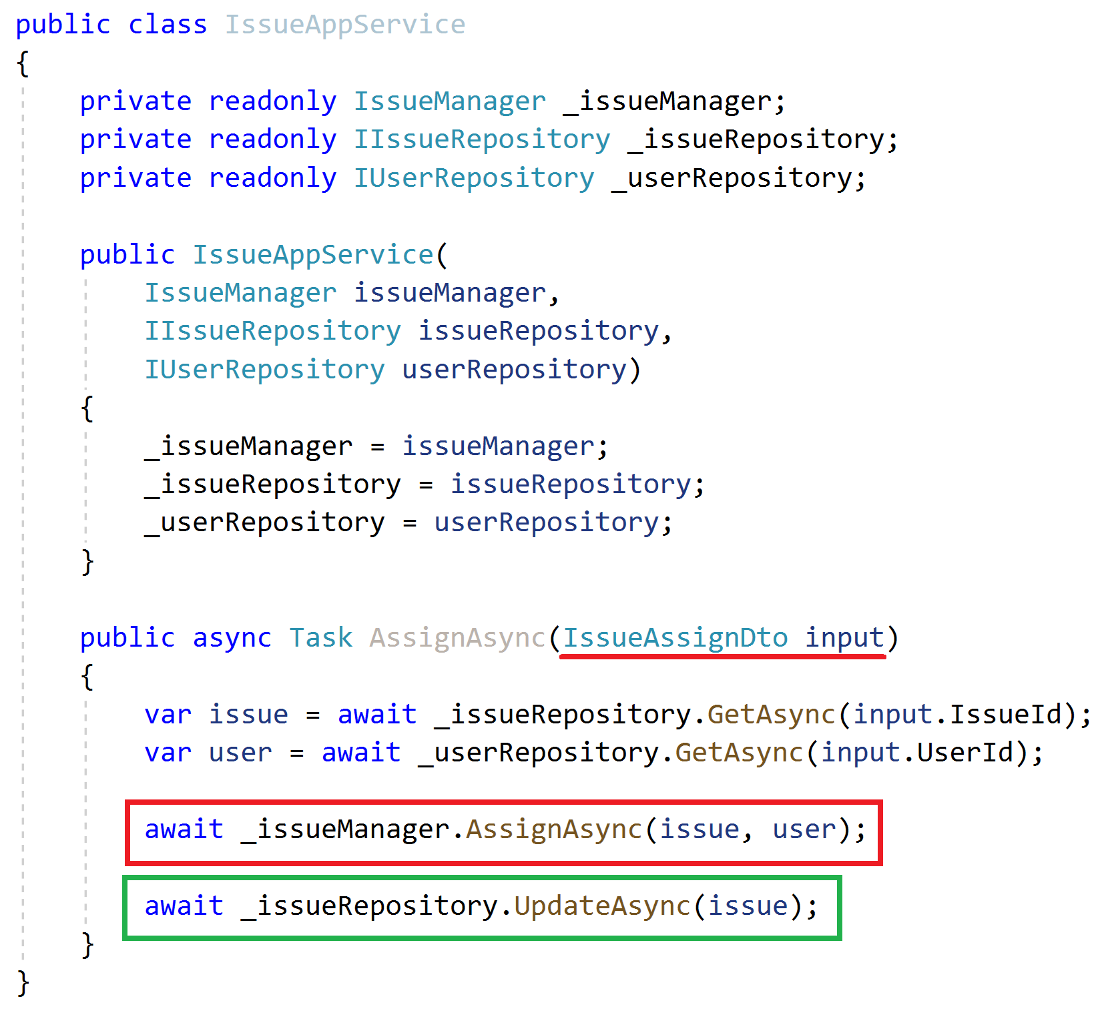
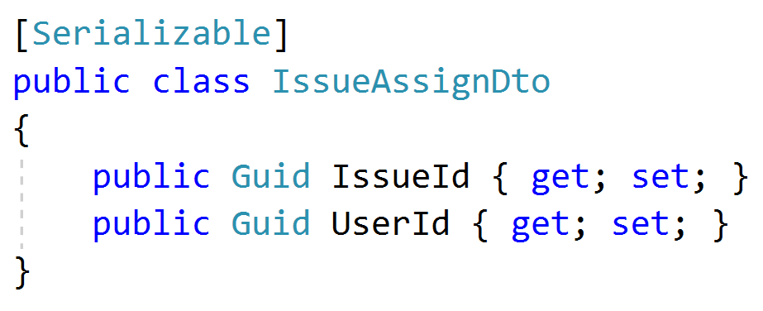
Application Services Example
Inject domain services & repositories
Get DTO as argument
Get aggregate roots from repositories
Use domain service to perform the domain logic
Always update the entity explicitly (don’t assume the change tracking)

Slide 39
Application Services Common DTO best practices
Should be serializable
Should have a parameterless public constructor (implicit/explicit)
Should not contain any business logic
Never inherit from entities! Never reference to entities!

Slide 40
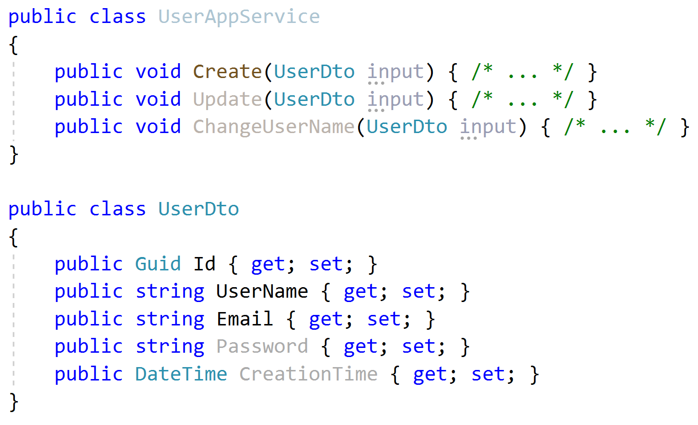
Application Services Input DTO best practices
Define only the properties needed for the use case
Do not reuse same input DTO for multiple use cases (service methods)
Id is not used in create! Do not share same DTO for create & update!
Password is not used in Update and ChangeUserName!
CreationTime should not sent by the client!

Slide 41
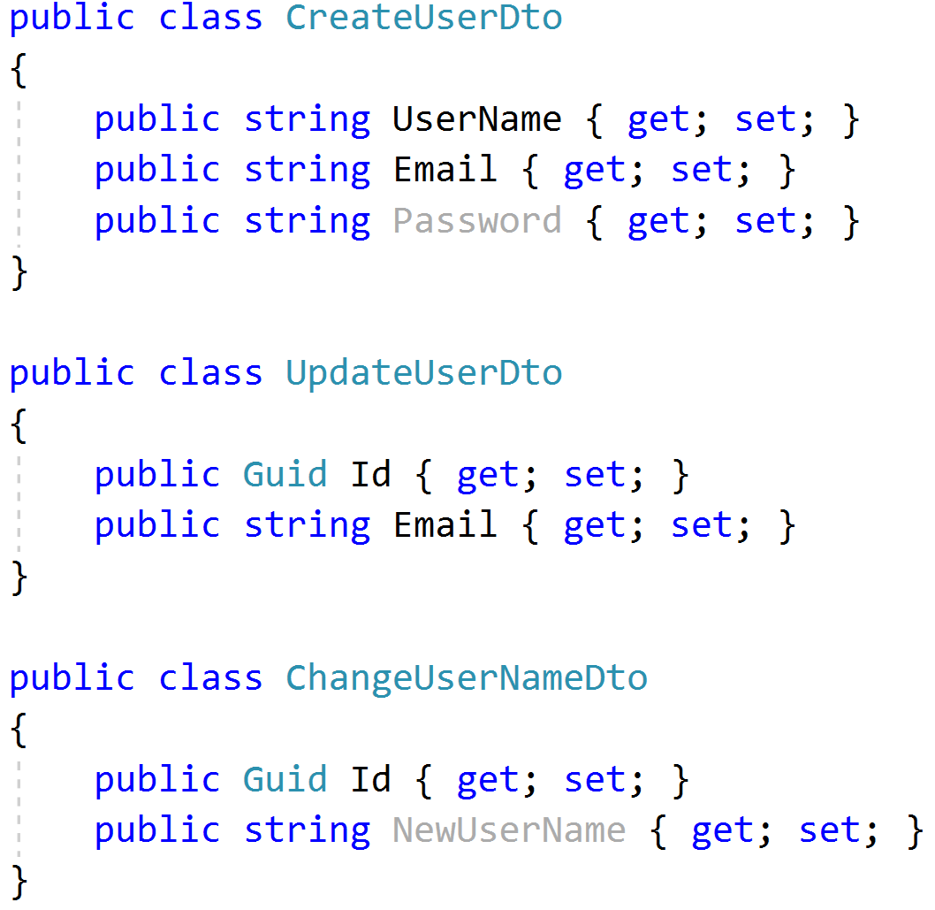
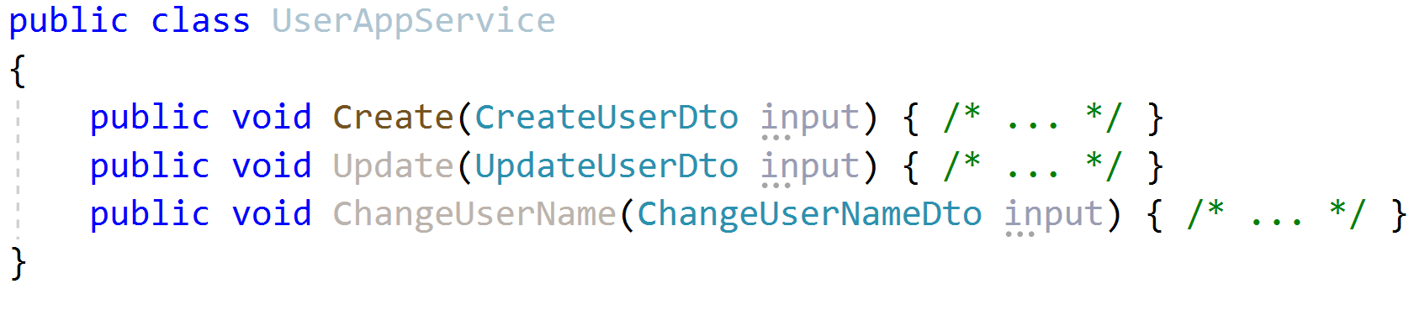
Application Services Input DTO best practices
Define only the properties needed for the use case
Do not reuse same input DTO for multiple use cases (service methods)

Slide 42
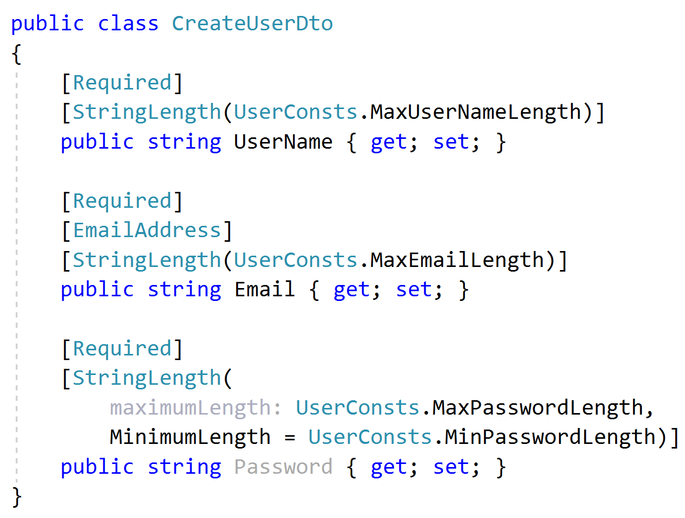
Application Services Input DTO best practices
Implement only the formal validation (can use data annotation attributes)
Don’t include domain validation logic (ex: unique user name constraint)

Slide 43
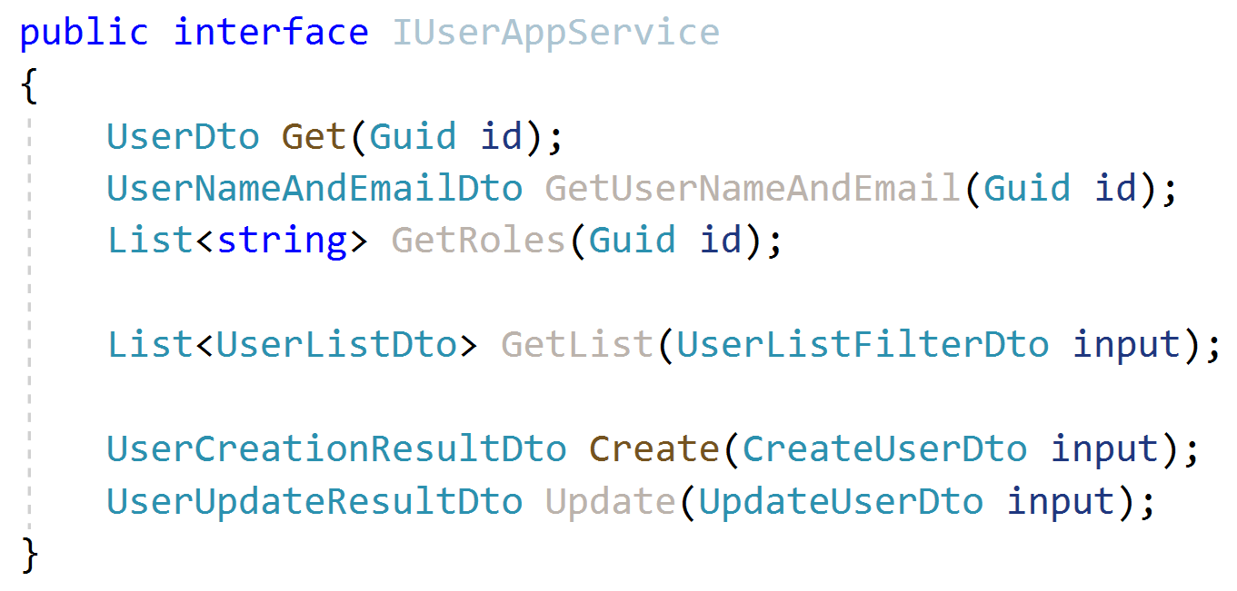
Application Services Output DTO suggestions
Keep output DTO count minimum. Reuse where possible (except input DTOs as output DTO).
Return the entity DTO from Create & update methods.
Can contain more data than client needs
Exception: Where performance is critical, especially for large result sets.

Slide 44
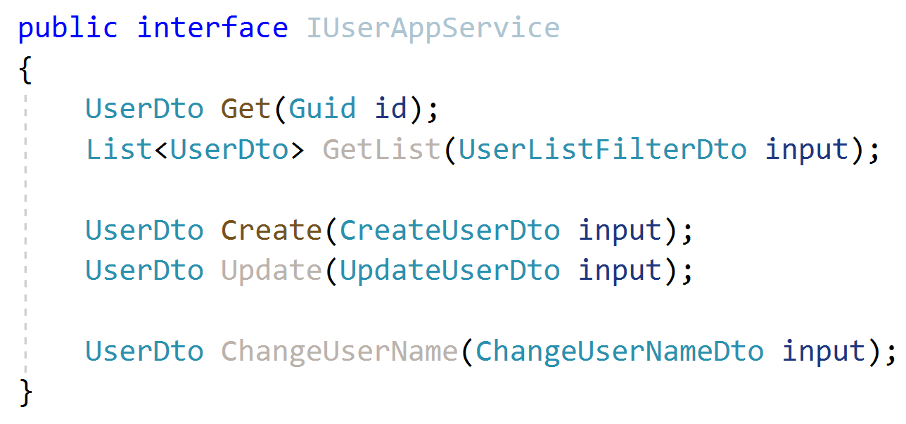
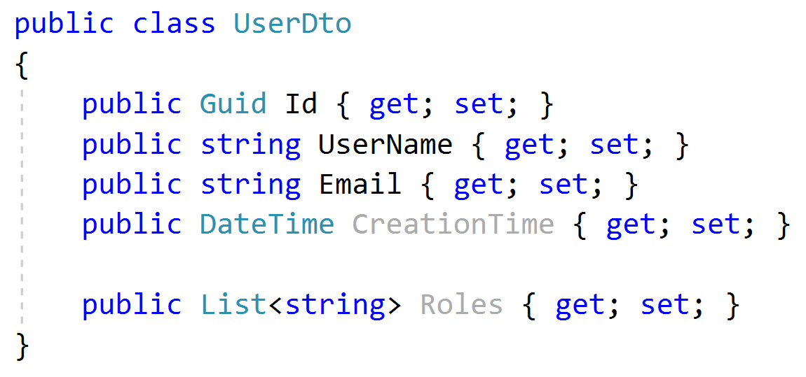
Application Services Output DTO suggestions
Keep output DTO count minimum. Reuse where possible (except input DTOs as output DTO).
Return the entity DTO from Create & update methods.
Can contain more data than client needs
Exception: Where performance is critical, especially for large result sets.

Slide 45
Application Services Object to Object Mapping
Use auto object mapping libraries (but, carefully – enable configuration validation)
Do not map input DTOs to entities. Map entities to output DTOs

Slide 46
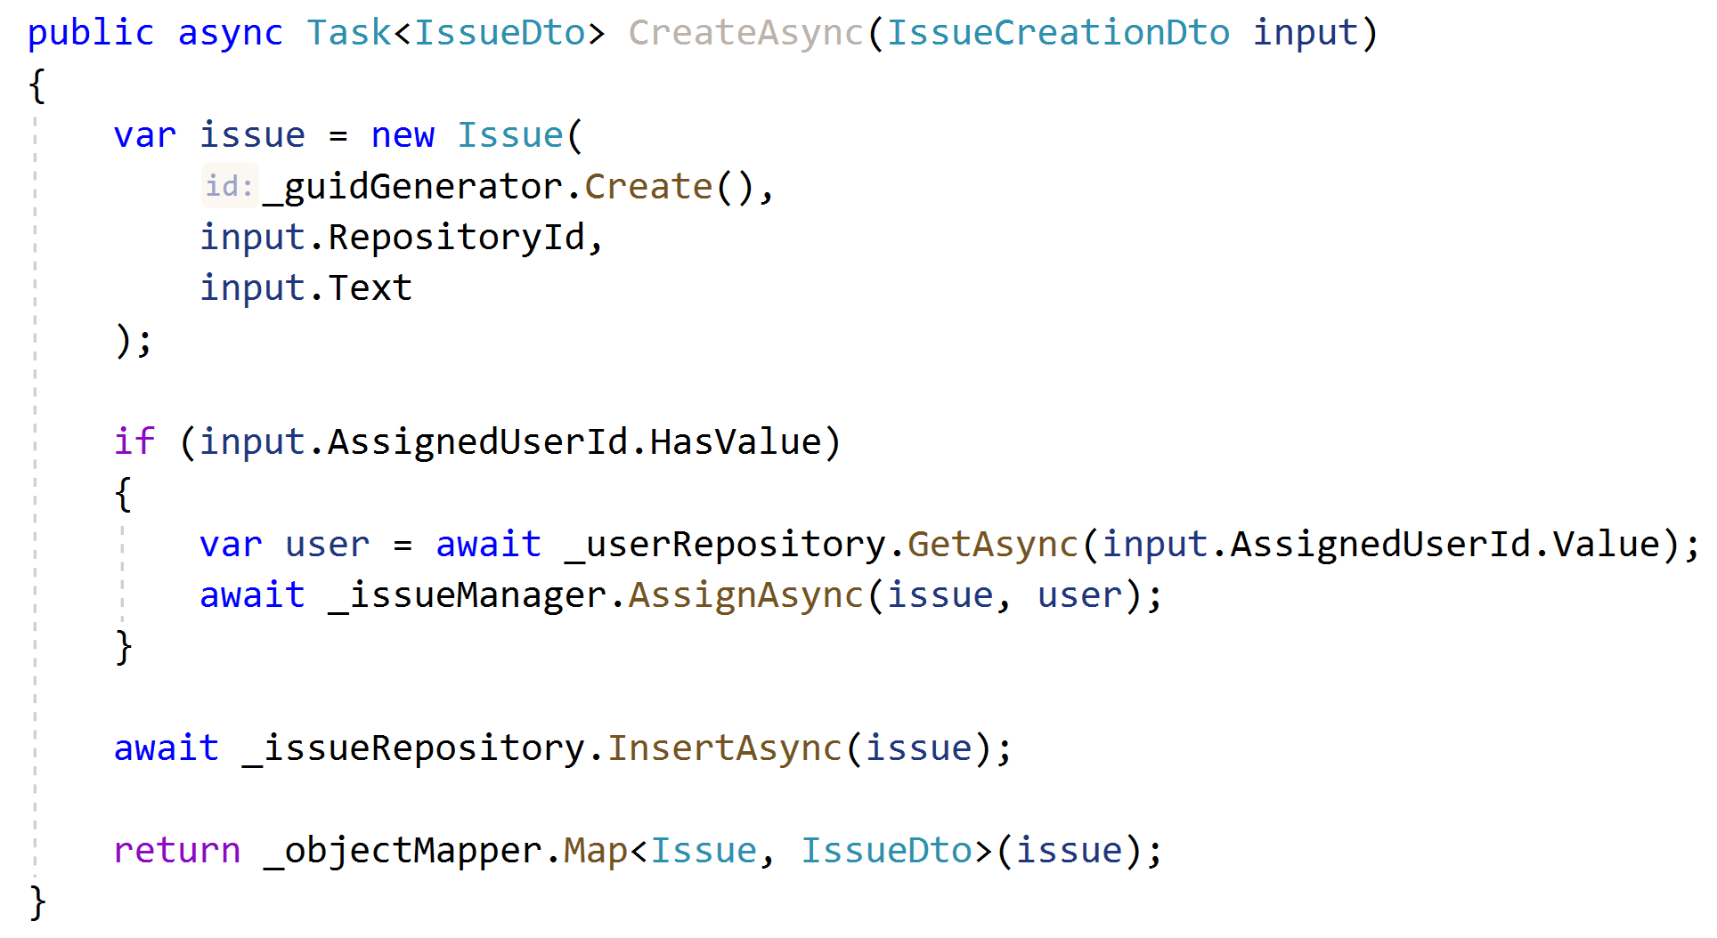
Application Services Example: Entity Creation
Don’t use DTO to entity auto-mapping, use entity constructor.
Perform additional domain actions.
Use repository.
Return DTO using auto-mapping.

Slide 47
Domain/Business Exceptions
Do not return null or operation result code for exceptional cases, throw exceptions!
Define exception classes for important business rules
Include an error code in the exception
Separate localization from exception throwing
Map exceptions to HTTP status codes

Slide 48
Domain/Business Exceptions

